Slide 1
Java 8 Method References
momedaram

Slide 2
Method references :
Are shortened versions of lambda expressions calling a specific method.
Are the easiest way to refer a method than the lambdas calling a specific method.
Method references will enhance the readability of your code.
Method reference to static method :
ClassName::MethodName
Ex : Integer::parseInt, Math::max
Method reference to instance method :
ReferenceVariable::MethodName
Ex: s::getName
We can also refer to the constructor of a class same as method references.
ClassName::new
Ex : Employee::new

Slide 3
Examples of Method References
Lambda Expressions | Equivalent Method References
(String s) - > System.out.println(s); | System.out::println
(String s) -> s.toLowerCase(); | String::toLowerCase
(String s) -> Integer.parseInt(s); | Integer::parseInt
(Employee e)-> e.getName(); | Employee::getName
() -> new Employee(); | Employee :: new

Slide 4
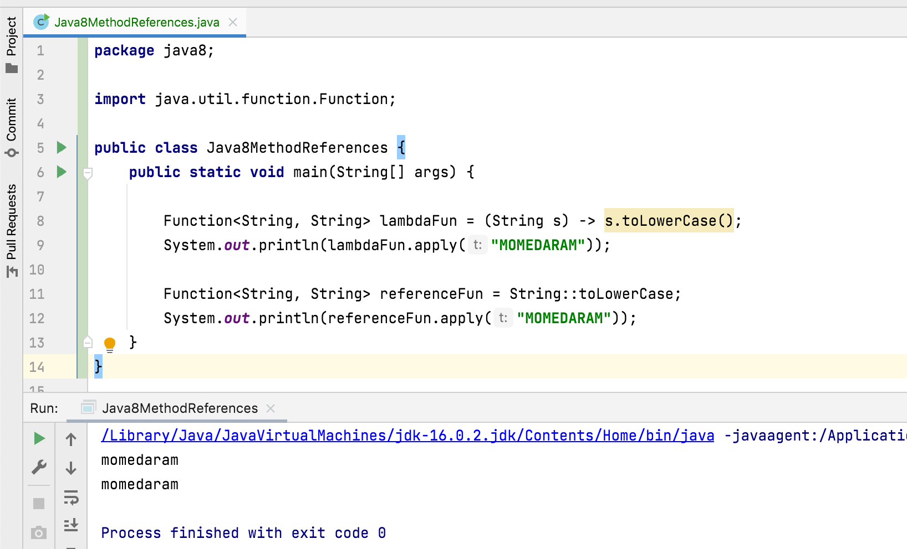

Slide 5
Thank You !
momedaram

